Slide 1


DISABILITY REGISTRATION ANALYSIS
Presented by Aneesh Mukherjee

Slide 2


OVERVIEW
Introduction
Insights
Objectives
Outliers and Observations
Methodology
Conclusion

Slide 3
INTRODUCTION
Disability registration data provides critical insights for healthcare and social policy planning.
Purpose: to analyze patterns in registrations to identify high-need areas and demographic trends.
Scope: to cover registrations by district, gender, age group, and disability type, focusing on trends and anomalies.
Importance: to inform resource allocation, accessibility improvements, and targeted interventions.

Slide 4
OBJECTIVE
Identify districts with the highest disability registrations.
Analyze gender-wise and age-wise distribution of registrations.
Determine the most common disability types.
Highlight trends, outliers, and anomalies for further investigation.
Provide actionable insights for policymakers and stakeholders.

Slide 5

METHODOLOGY
DATA SOURCE AND TOOLS USED
QUANTITATIVE
Aggregated registrations by district, gender, age group, and disability type.
Computed sums, grouped data, and visualized distributions.
Cleaned aggregated dataset with 3,309 records.
Tools: Python (pandas for data manipulation, matplotlib/seaborn for visualization).

Slide 6
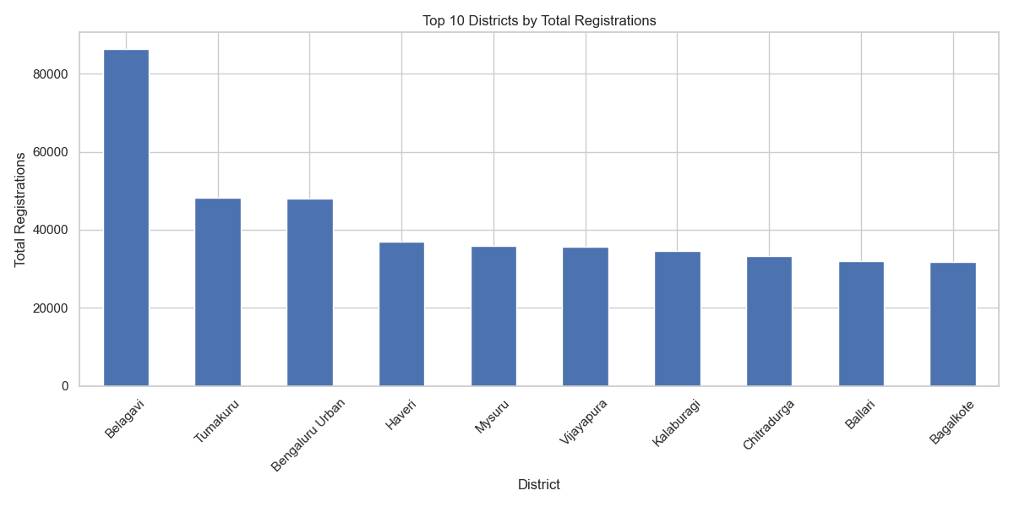
INSIGHT
DISTRICT-WISE REGISTRATIONS
Total registrations: 869,244 across 31 districts.
Top districts:
- Belagavi: 86,288 (9.9% of total)
- Tumakuru: 48,246
- Bengaluru Urban: 47,979
Observation: belagavi significantly leads, nearly double the registrations of the next highest district.

Slide 7
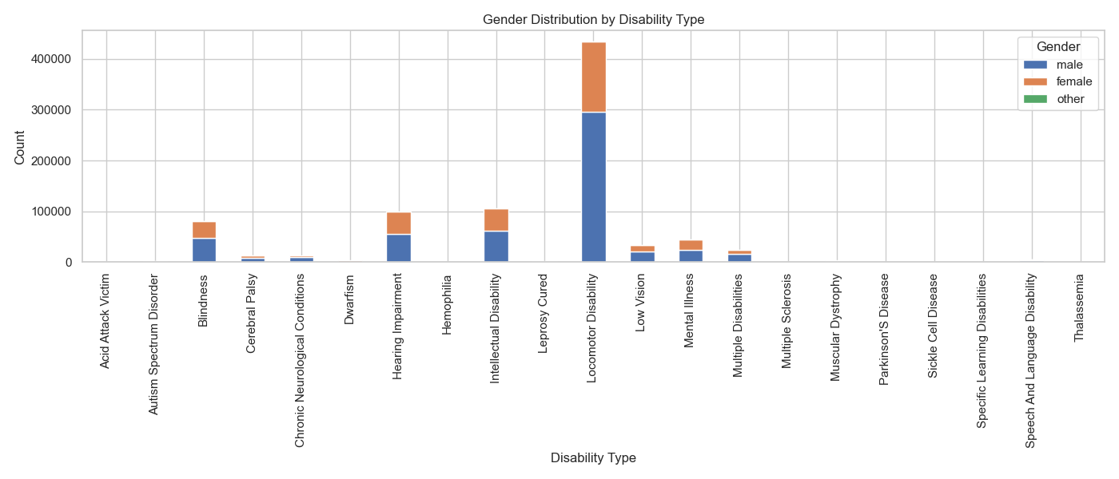
INSIGHT
GENDER-WISE DISTRIBUTION
Total:
- Male: 555,911 (64.0%)
- Female: 313,182 (36.0%)
- Other: 151 (0.02%)
Observation: significant male predominance, possibly indicating gender-specific access or prevalence differences.

Slide 8
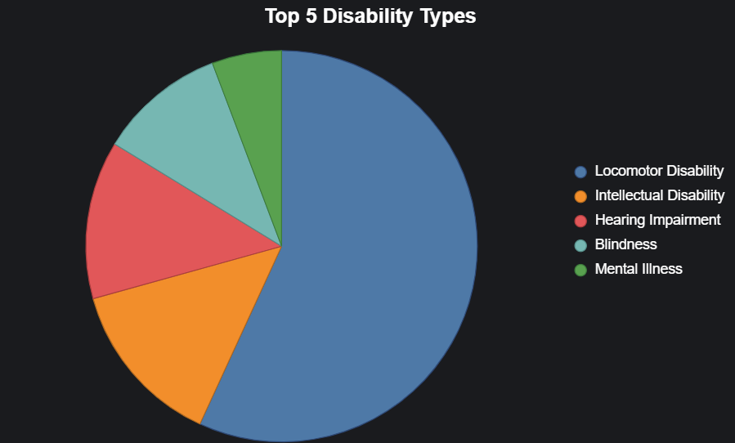
INSIGHT
DISABILITY TYPES
TOP DISABILITIES:
- Locomotor Disability: 433,714
- Intellectual Disability: 105,454
- Hearing Impairment: 99,667
Observation: locomotor disability dominates, nearly half of all registrations.

Slide 9
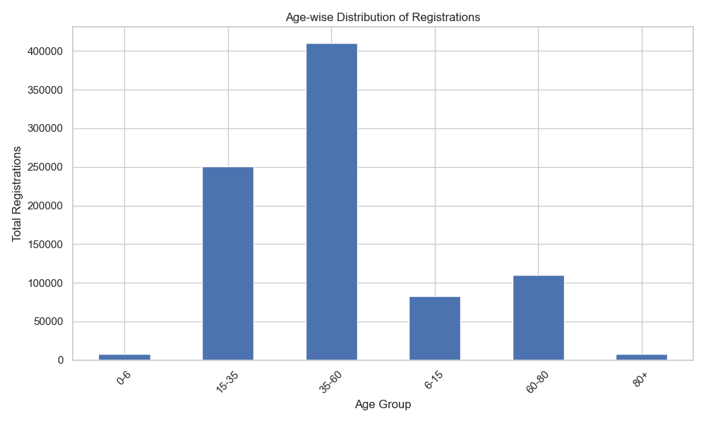
INSIGHT
AGE-WISE DISTRIBUTION
Distribution:
- 35-60: 410,560 (47.2%)
- 15-35: 250,752 (28.8%)
- 60-80: 110,018 (12.7%)
- 6-15: 82,683 (9.5%)
- 0-6: 7,721 (0.9%)
- 80+: 7,510 (0.9%)
Observation: middle-aged adults (35-60) form the largest group, suggesting higher prevalence or reporting in this age range.

Slide 10
OUTLIERS AND TRENDS
OUTLIERS AND TRENDS
OUTLIERS:
Belagavi’s registrations (86,288) are significantly higher than others (next highest: Tumakuru at 48,246).
Other” gender category is extremely low (151 registrations).
TRENDS:
Locomotor Disability is the most prevalent, nearly half of all cases.
Middle-aged adults (35-60) dominate registrations, followed by younger adults (15-35).
Male registrations significantly outnumber female (64% vs. 36%).
Anomalies: low registrations in certain districts (e.G., Kodagu: 7,016) may indicate under-reporting or access issues.

Slide 11
OBSERVATIONS TO CONSIDER
OBSERVATION FOR FURTHER INVESTIGATION
- Why does Belagavi have exceptionally high registrations?
Possible factors: population size, awareness, or data collection efficiency.
- What causes the low “Other” gender registrations?
Potential under-reporting or social stigma.
- Are low registrations in districts like Kodagu due to access issues or lower prevalence?
- Why is there a male predominance in registrations?
Could reflect prevalence, access, or cultural factors.
- How accurate is the age group data?
Possible misclassification or reporting biases.

Slide 12
CONCLUSION
Key Insights: Belagavi leads in registrations, suggesting high prevalence or better reporting mechanisms.
Locomotor Disability is the most common, requiring targeted interventions.
Significant gender disparity (64% male) warrants further investigation.
Middle-aged adults (35-60) are the most affected group.
Recommendations: Investigate low-registration districts (e.g., Kodagu, Vijayanagar) for access barriers.
Address gender disparities in registration processes.
Focus resources on locomotor disability support and middle-aged populations.

Slide 13
THANK YOU

